Slide 1
The Right not to Have Rights: Posted Worker Acquiescence and Labour Rights Enforcement
Nathan Lillie
23 Oct 2014
This research was funded by the European Research Council's Starting Grant #263782, "Transnational Work and the Evolution of Sovereignty", and Academy of Finland's Project Grant #265572

Slide 2
“Transnational Work and the Evoluation of Sovereignty."
Nathan Lillie – TWES

Slide 3
Policy Problem of Posted Work
Posted work: when a company sends an employee abroad to work
Home country conditions - EU free movement
Workers in same physical space have different rights based on nationality of employer
Nathan Lillie – TWES
Notes:
3

Slide 4
Core Question
How does transnational work and the regulation around it change the relationship between states and citizens?
Nathan Lillie – TWES
Notes:
4

Slide 5
Variegated sovereignty
“spatial fragmentation” of regulation:
i.e. treating people differently based on status – in this case the origin of their employer
Ong (2006) Neoliberalism as exception: mutations in citizenship and sovereignty, p. 7
Nathan Lillie – TWES

Slide 6
Case Study Analysis
4 countries: Germany, UK, Finland, Netherlands
Interviews with posted workers
Management subcontracting strategy and industrial relations
Working conditions and positions in contracting chain
Individual migration strategies of workers
Union regulatory strategies
Relations between migrant and native workers
Nathan Lillie – TWES

Slide 7
Policy Interviews and text analysis
EU actors role: employer and unions associations, EU bureaucracies, politicians
Articulation between national actors and EU associations
Articulation into practice of EU political outcomes
Relationship between firm practice and formal institutional change
Nathan Lillie – TWES

Slide 8
We went to the work site ... and there were some Estonian workers, that were posted workers, and we asked ... what their salary was. Their foreman, who spoke Finnish, said that everyone of them got 10 euros per hour. After that we checked the contract between the client company and the employer, which was an Estonian company … and it said that some of the workers were being billed at 10 euros per hour and some 7 euros. So basically, what the contractor was billing the client for the workers was less than what the workers said they were being paid. When workers and employers do that kind of cash in hand deal, and say that the working conditions are other than what they are, then we are in practice pretty toothless, that is we don’t really have any tools to do anything, if the people concerned are of the opinion that everything is ok. (Finnish labour inspector)

Slide 9
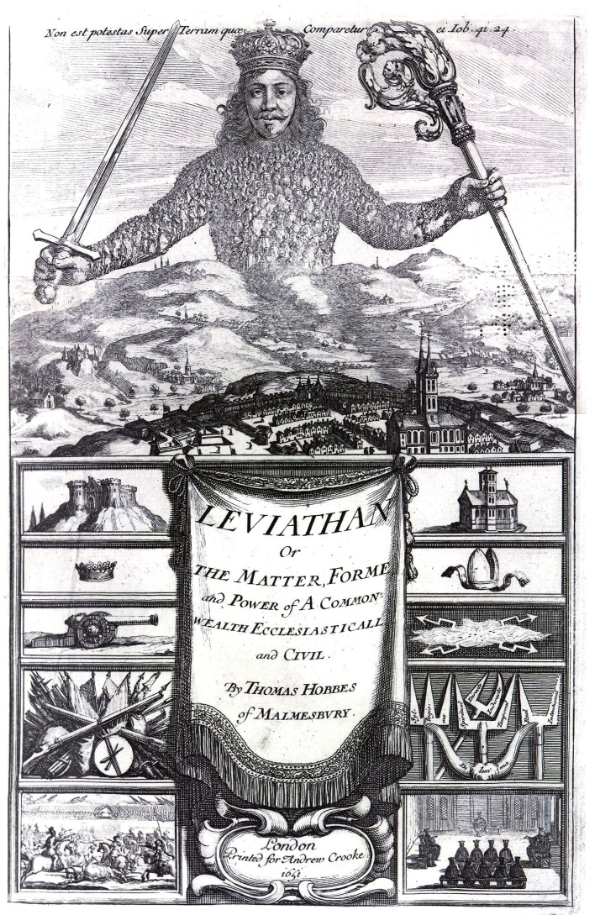
Hobbesian Bargain
“The right to have rights” hinges on membership in a particular community, in practice a particular nation state (Arendt 1976)
Workers choose be posted or look for work in host countries themselves, implicit (coerced) bargain that rights will not be evoked.
Employability depends on agreeing not to have rights
Bargain is necessity opaque, implicit, and informal, leading to semi-legal and illegal operation

Slide 10
theoretical right to freely engage in contracts of employment,
they cannot usually enforce these contracts; post-hoc revision by employers, or exploitation of unclarities
epidemic of wage theft

Slide 11
Enforcement of CBAs and labour laws made difficult
So every time you have to figure out exactly what is the law that applies to this person. You know, does he have a Dutch contract? Does he have a Polish contract or a Romanian contract? Is he even under EU law? And that makes it almost impossible for us to really organize these people.

Slide 12
Settled in mobility and insecurity migrant labour market and trade union experiences in an enlarged EU (Berntsen, PhD thesis 2015)
“the common pragmatic response of [posted] workers to substandard employment is to either accept these conditions or to move on to a better job opportunity, they avoid challenging the way cross-border employment is organized and instead contribute to the continuation of current labour relations.”
(Berntsen 2015, based on interviews with posted construction workers in Netherlands)

Slide 13
Laval Quartet
C-341/05 Laval un Partneri [2007] ECR I-11767
C-346/06 Rüffert [2008] ECR I-1989
C-319/06 Commission vs Luxembourg [2008] ECR I-4323
C-438/05 The International Transport Workers’ Federation and The Finnish Seamen’s Union [2007] ECR I-10779
C-396/13 Sähköalojen ammattiliitto ry [2015]

Slide 14
C-396/13 Sähköalojen ammattiliitto ry v. Elektrobudowa Spółka Akcyjna [2015]
CJEU reference from Satakunta labour court
Questions:
Right of union to represent Polish workers in court?
application of CBA pay scales and application of supplementary payments and allowances to the minimum wage?

Slide 15
How are posted workers represented/protected in Europe?
Via membership in home country unions - never actually happens
Via membership in host country unions
Not usually members, and if so it is only for short term, usually instrumental when seeking legal aid
Organizing
active strategies to go to worksites and convince workers to join
Mobilizing
involvement via participation in some union action (strike)
Alternatively, solidaristic secondary action by host country workers can be effective
Labour inspection
Autonomous organization
- networks, wildcat strikes
main contractor liability (and public contracting standards)

Slide 16
What does EU law allow?
Via home country unions - was pushed in the Laval case
But usually no capacity or inclination to do this
Via host country unions - the major way they have standards enforced but limited to PWD directive and legal extension,
practice often unclear but enforcement of wage standards for PWs limited to extended agreements and minimum wages
Organizing
Resource intensive, requires ideology, appropriate union structure
Mobilizing
Hard to do
Secondary action not permitted in most countries or situations
Labour inspection – (potentially) constrained by Enforcement Directive
Own organization - hard to do and rarely turns out well
main contractor liability, (potentially) constrained by Enforcement Directive
Public contracting standards prohibited by Rüffert decision

Slide 17
 | Extension Mechanism | Shop floor union structures | Main Contractor Liability | Labour Inspection
Finland | Legal extension of industry CBAs | Strong in domestic firms | weak | subordinate to union strategy
Estonia | no CBAs | None | none | weak
Germany | minimum wage | weak via works councils | strong | Criminal law oriented
Netherlands | Legal extension of industry CBAs | weak but unions seek to improve | medium | Fragmented
United Kingdom | CBA extended site-by-site | Strong | none | No data
NOTE: ONLY INVOLVES THE SITES WE RESEARCHED (INDUSTRIAL CONSTRUCTION)

Slide 18
EASI project
Posting of Workers: enhancing administrative cooperation and access to information
EU Commission DG EMPL funded project
Project goal is to strengthen worker protection and union rights for posted workers in the new environment
We will summarize and apply lessons from the research, and experiences of practitioners, to develop best practices in cooperation with labour inspectors, trade unionists and other stakeholders.
Workshops: Bryssel, Helsinki, Padova, Wien, Oslo, Praha

Slide 19
Partners
Uni Tampere (Markku Sippola)
Multicultural Centre Prague (NGO)
EFBWW (European Federation of Building and Woodworkers)
EFFAT (European Federation of Food, Agricultural and Tourism Workers)
Czech Labour Inspection
JyU (coodinator)
DG EMPLOY (funder)
Uni Padua
FORBA, Vienna
SOLIDAR (NGO, Bryssel)
FAFO tutkimusinstituutti, Oslo
Suomalainen työsuojeluvirasto
Italian labour inspection
Austrian labour inspection

